Slide 1

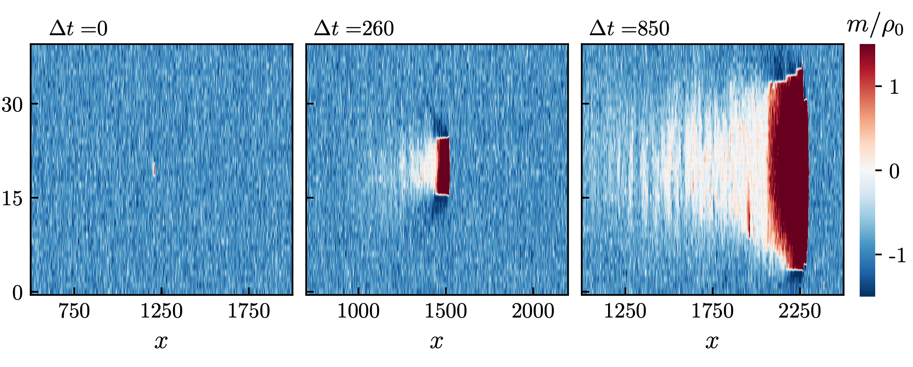
Metastability of Discrete-Symmetry Flocks
Brieuc Benvegnen et al. (2023)
Daniel Haim Breger, January 28th 2026

Slide 2
Background
Equilibrium ordered phase is expected to be stable in $d>1$ (Mermin-Wagner).
Finite perturbations expected to shrink
Recent results questioned this:
Small obstacle can break the order in noisy system
Constant-density flocks are metastable to spontaneous nucleation

Slide 3
In This Paper
Can a flocking transition be induced for any system size? Yes.
Can this transition happen spontaneously? Yes.
Flocking scalar polar models of $d≥2$ shown to have metastable ordered phase
Finite droplet of opposite polarization grows ballistically, taking over system
Shown numerically and analytically

Slide 4
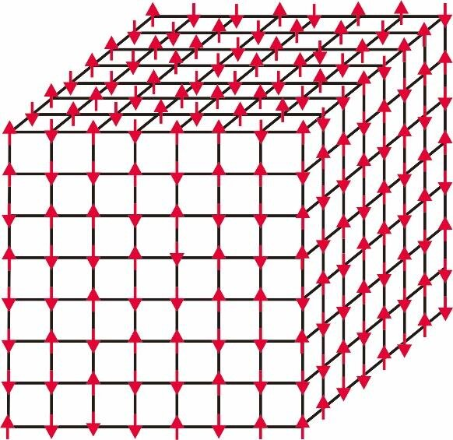
The Model
Active Ising Model
spin: $s=±1$
Position: ${\overset{⃗}{i}}_{n+1}={\overset{⃗}{i}}_{n}+s\overset{̂}{x}$ plus diffusion with rate $D$
Occupancy at each site unrestricted
On-site ferromagnetic spin flipping
$$ρ_{\overset{⃗}{i}}=n_{\overset{⃗}{i}}^{+}+n_{\overset{⃗}{i}}^{-}m_{\overset{⃗}{i}}=n_{\overset{⃗}{i}}^{+}-n_{\overset{⃗}{i}}^{-}$$
3D Ising Model Illustration. Zhang, Zhidong. (2025)

Slide 5
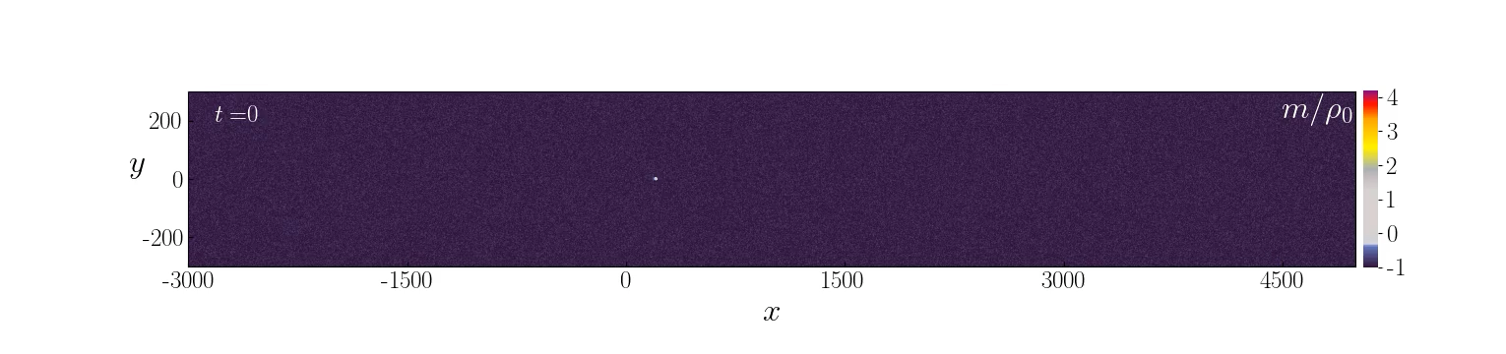
Induced Transition
In 2D

Slide 6
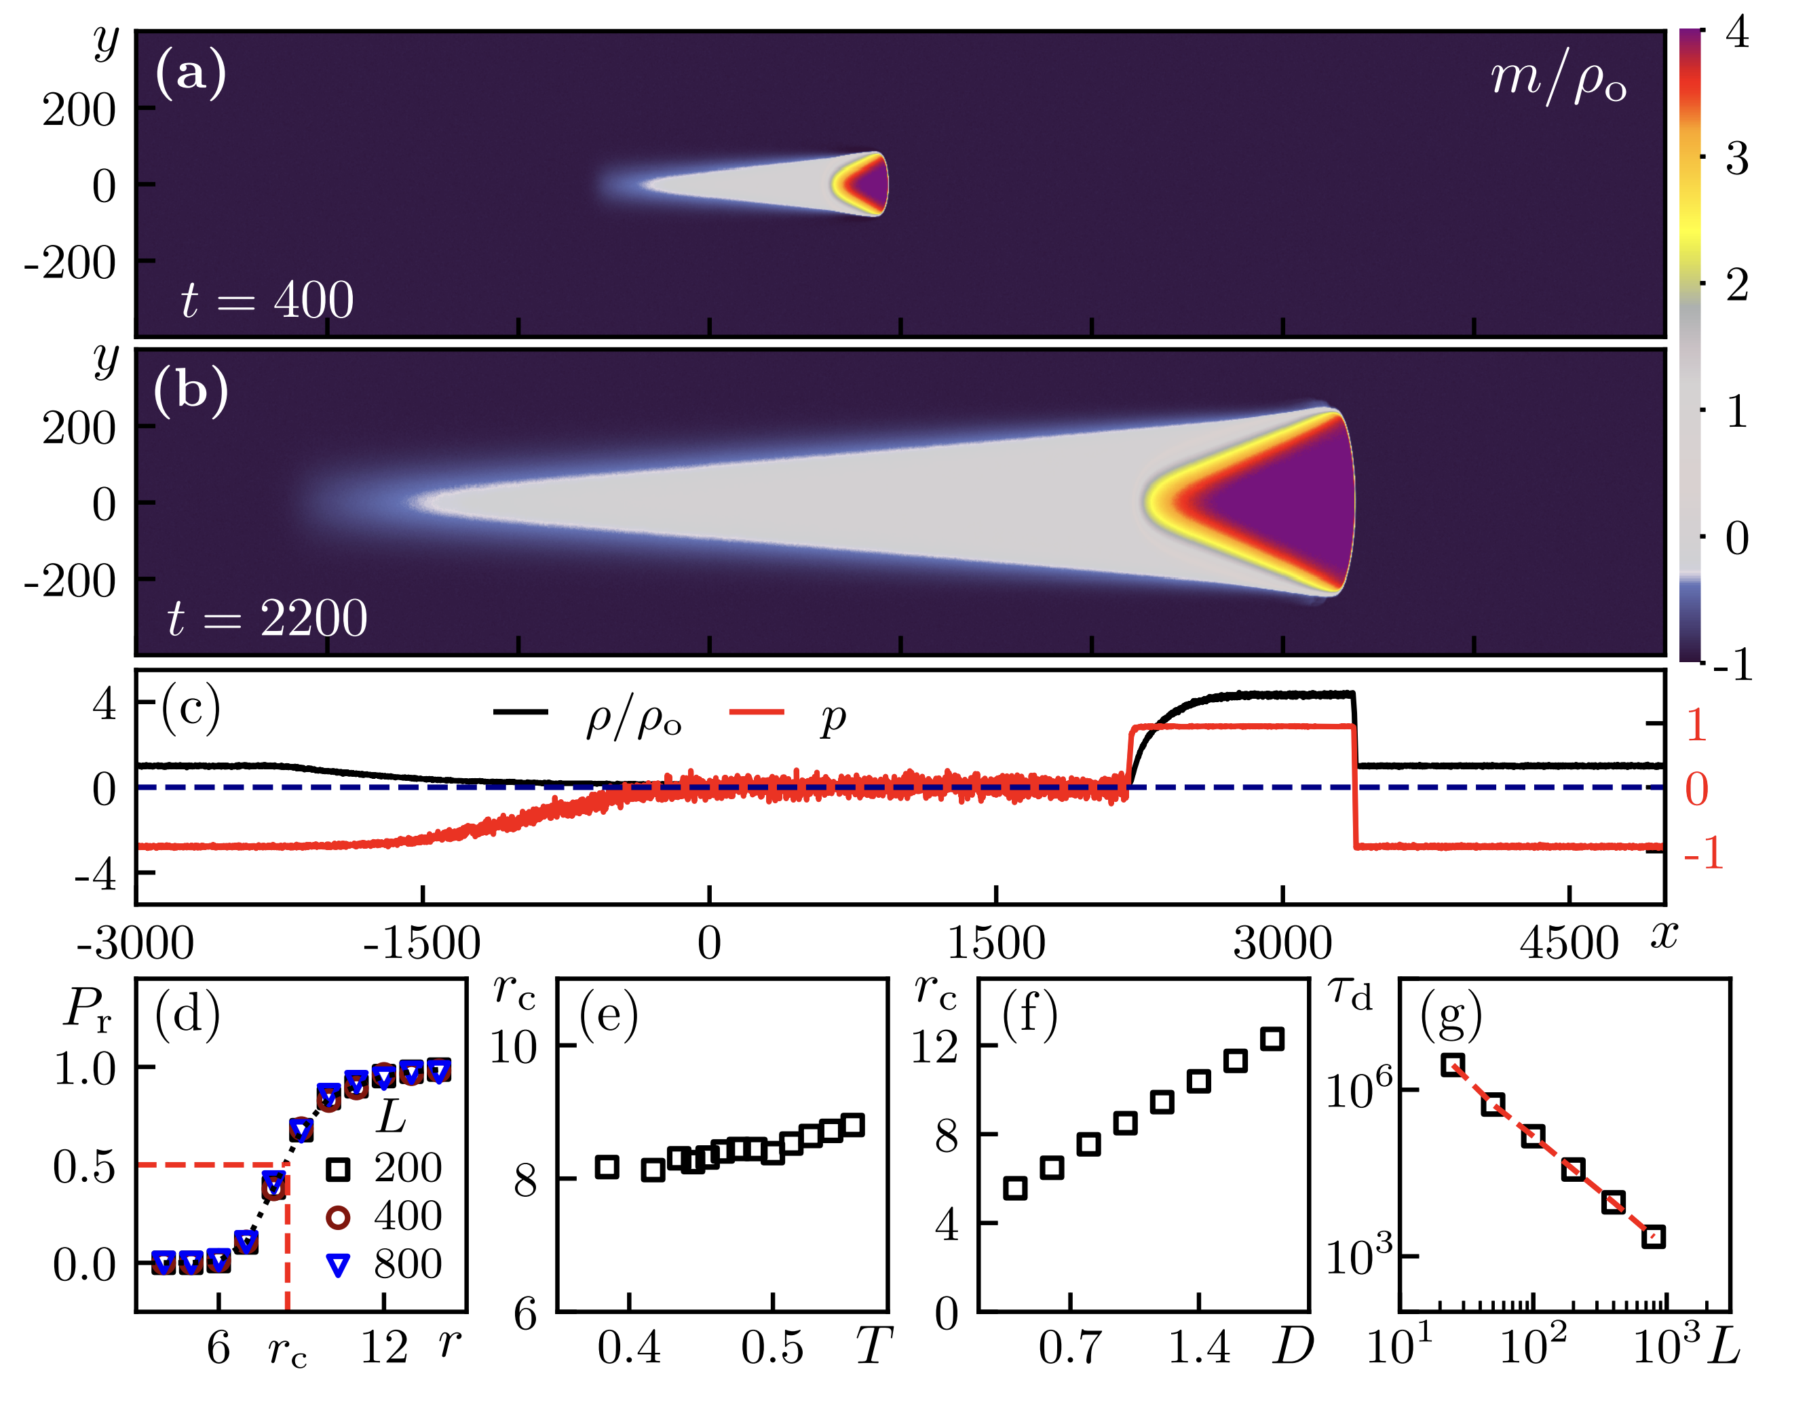

Slide 7
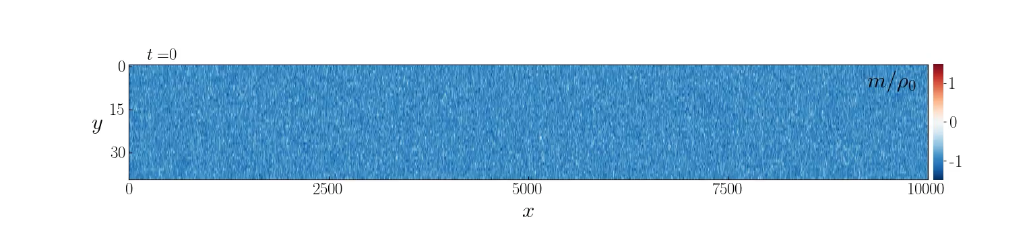
Spontaneous Transition
In 2D

Slide 8
Analytic Description
Not in detail
Hydrodynamic Equations defined for magnetization and density
$$∂_{t}ρ=-v∂_{x}m+∇⋅\overset{⃗}{D}∇ρ∂_{t}m=-v∂_{x}ρ+∇⋅\overset{⃗}{D}∇m+F(ρ,m)$$
Numerical integration gives solutions that fit simulations
Three domain walls characterized by the above equations

Slide 9
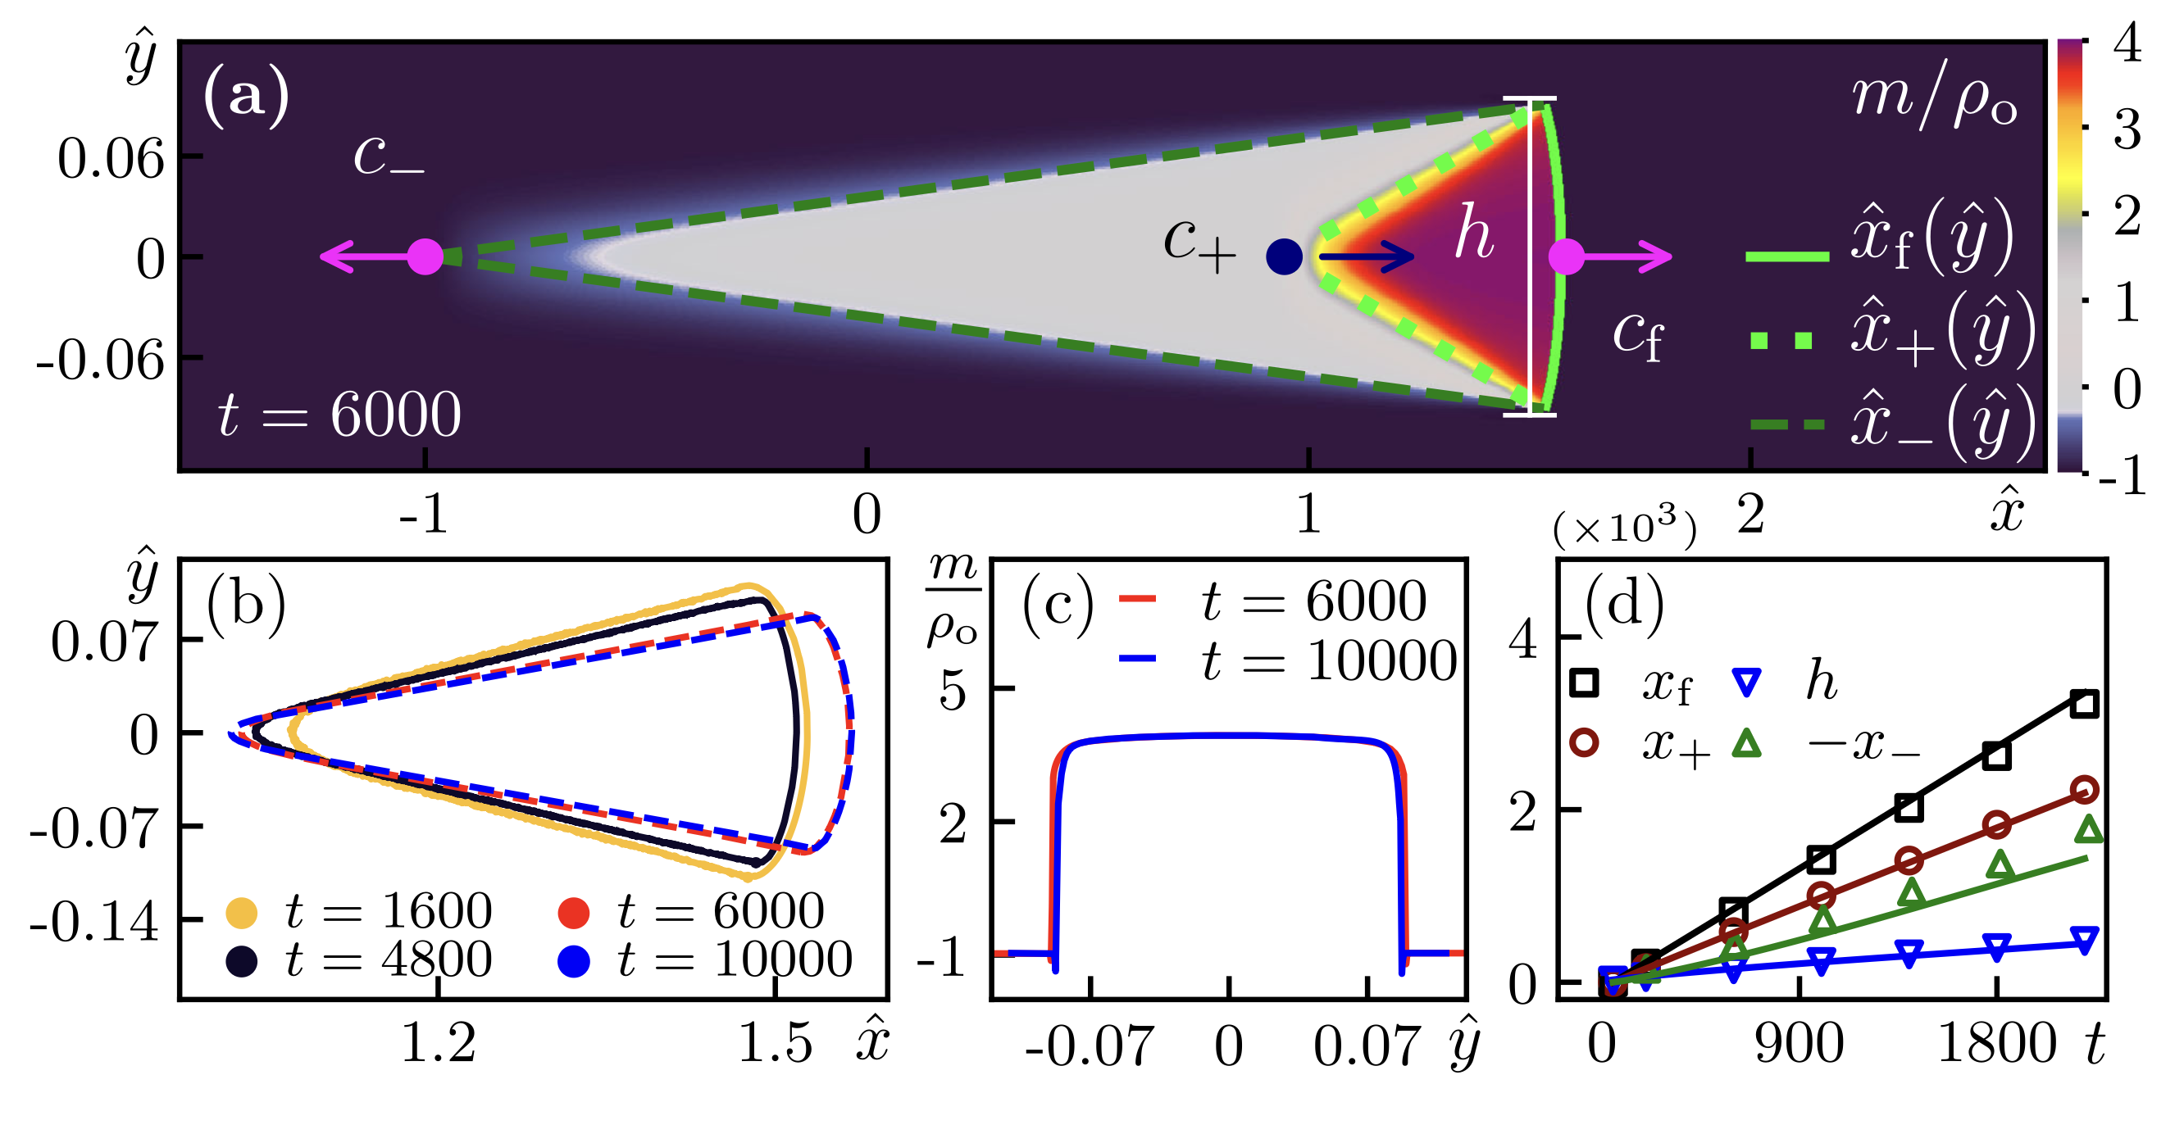

Slide 10
Summary Of The Results
The critical radius
Independent of system size
Shrinks with decreasing temperature
linear with diffusion
Spontaneous transition possible with low diffusion
time to nucleation $τ∼L^{-2}$

Slide 11
Conclusion:
Flocking phase is metastable in thermodynamic limit.

Slide 12
Further Research
More complex geometry & movement
Large systems
Interplay of multiple nucleations
Continuous symmetries
Directional polarization?

Slide 13
Thank you

